Slide 1


Job Analytics

Slide 2
Project Team Members
Mohammad Sohal
Prashant Mane
Jitesh More

Slide 3






Agenda
Project Details
Technology and Tools
Strategy Discussion
Database Information
Insights
Challenges & Learning
Future Scope
Dashboard

Slide 4
Project Details
Problem Statement
Scrape data from the professional networking platform Linkedin using Python library called Beautifulsoup (or similar) and collate information in the in specific format and make 3 tables using the data
All the details can be found on the link 🔗Click here

Slide 5
Technology and Tools
Python
Selenium
Beautiful Soup
Pandas
Numpy
SQL
Tableau
Excel

Slide 6
Strategy Discussion
Understanding the Object and Task Distribution in Team
Linkedin Automation for Login
Data Scraping
Data Visualization
EDA
Data Manipulation

Slide 7
Database information
Sample Dataset
Designation | Name | Location | Level_and_involvement | Total_applicants | Industry_and_Employee_count | LinkedIn_Followers
Data Scientist- WFH | Uplers | Chennai, Tamil Nadu, India | Full-time Â· Mid-Senior level | 165 applicants | 1,001-5,000 employees Â· IT Services and IT Consulting | 668,055 followers
Technology Lead - Devops (5-8 years) - Jaipur | Infosys | Jaipur, Rajasthan, India | Full-time Â· Mid-Senior level | 17 applicants | 10,001+ employees Â· IT Services and IT Consulting | 6,456,650 followers
Data Engineer | Tata Consultancy Services | Bengaluru, Karnataka, India | Full-time Â· Mid-Senior level | 8 applicants | 10,001+ employees Â· IT Services and IT Consulting | 11,322,348 followers
Lead Administrator | Wipro | Pune, Maharashtra, India | Full-time Â· Mid-Senior level | 10 applicants | 10,001+ employees Â· IT Services and IT Consulting | 6,403,627 followers

Slide 8
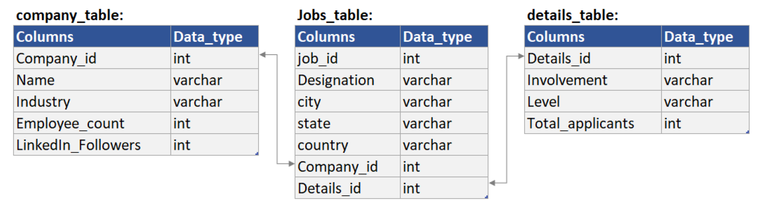
Database Information
Schema

Slide 9
Insights
IT industry offers more vacancies compared to others
Bangalore has the highest number of jobs
Within Bangalore more companies are available along with different fields of job

Slide 10
Challenges and Learning
The ultimate challenge was how to scrape data from the website.
Then on the first day we had done some research about web scraping.
And we found that selenium would best fit our requirements.
We have learned about selenium from various resources.
Reference links:
https://youtu.be/lTypMlVBFM4
https://youtu.be/Xjv1sY630Uc
Official Documentation:
https://www.selenium.dev/documentation/

Slide 11
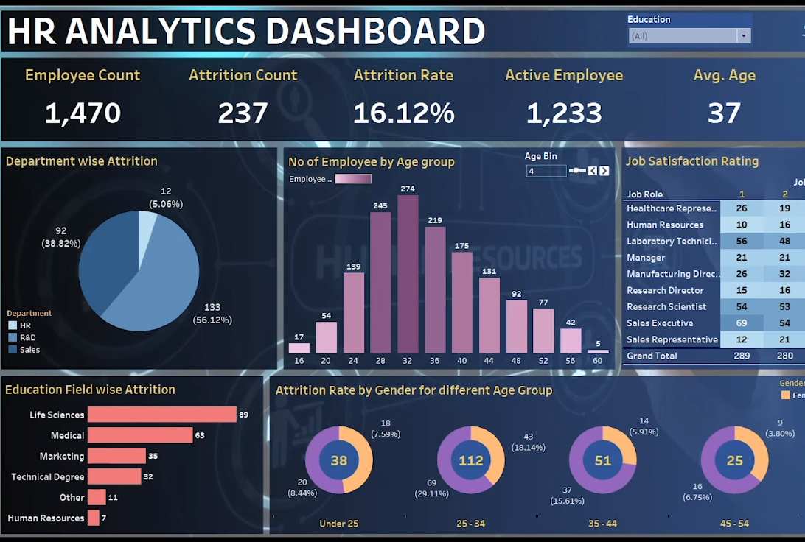
FUTURE SCOPE
By making some little changes we can use it for HR Analytics.

Slide 12

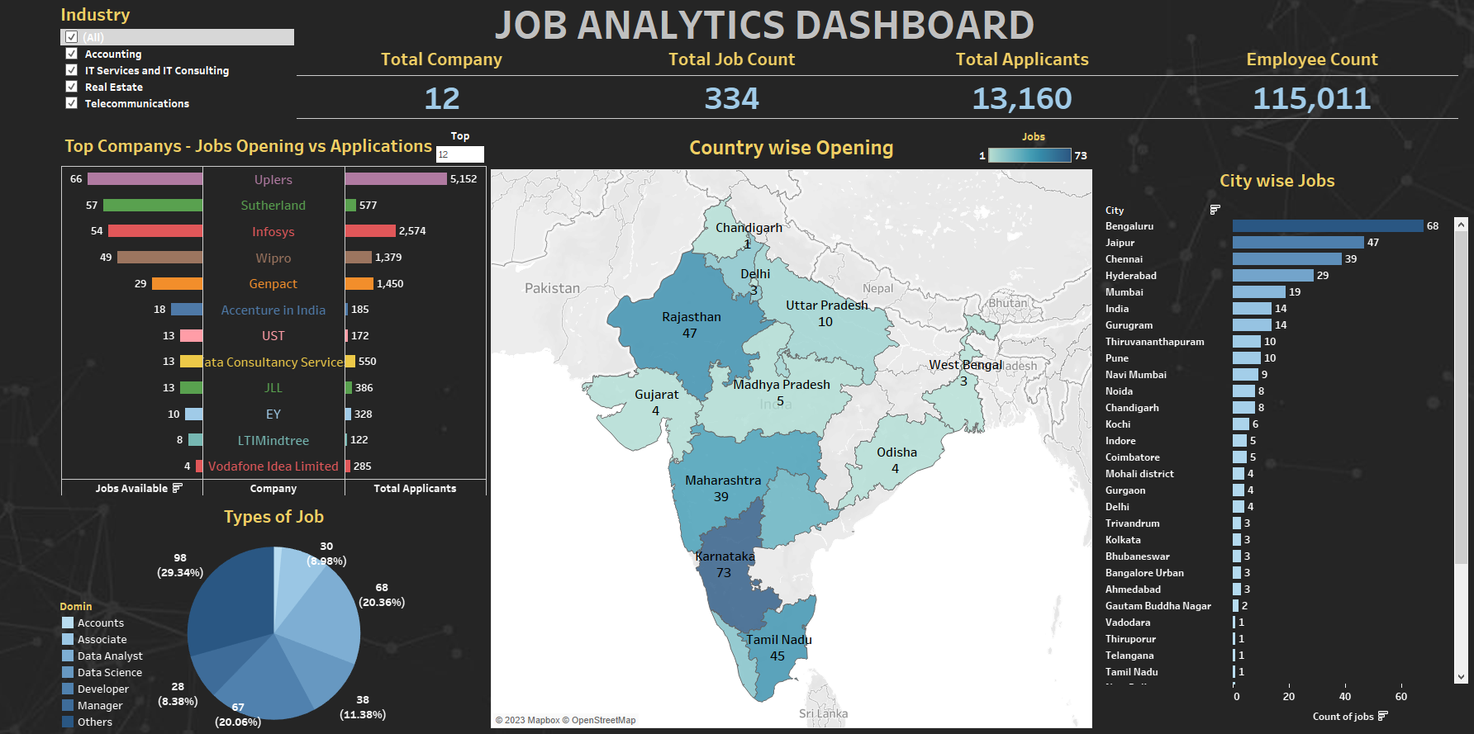
Dashboard

Slide 13
Thank you

